Slide 1

Scripting no Processamento
de Linguagem Natural
Mestrado em Engenharia Informática

Slide 2
Jinja (v. 2.11)
Homepage: https://jinja.palletsprojects.com/
Source Code: https://github.com/pallets/jinja/ Web Template Engine (HTML, XML, CSV, LaTeX, etc.) utilizado pela web-framework Flask (ambas criadas por Armin Ronacher). Websites populares criados com esta tecnologia: Pinterest e a página de campanha do Barack Obama.
Sand boxed execution
Automatic HTML escaping to prevent cross-site scripting (XSS) attacks
Template inheritance
Compiles down to the optimal Python code just-in-time
Optional ahead-of-time template compilation
Easy to debug (for example, line numbers of exceptions directly point to the correct line in the template)
Configurable syntax

Slide 3
Exemplos
<!DOCTYPE html> <html> <head> <title>{{block title}}{{end}}</title> <link rel="stylesheet" href="{{ url_for('static', filename=style.css') }}"> </head> <body> {{block content}}{{end}} </body> </html>
{% extends "layout.html" %} {% block title %}SPLN{% endblock %} {% block content %} <ul> {% for user in users %} <li><a href="{{ user.url }}">{{ user.username }}</a></li> {% endfor %} </ul> {% endblock %}
<div class="container"> <!--Variável contida--> {% with messages = get_flashed_messages() %} <!--ComeCondição if-> {% if messages %} {#<!--Comentário->#} <ul id="messages" class="list-unstyled"> <!--Loop--> {% for message in messages %} <li class="alert alert-success">{{ message }}</li> <!--Print--> {% endfor %} <!--Fim do Loop--> </ul> <!--Fim do If--> {% endif %} <!--Fim da variável--> {% endwith %} </div>
@app.route('/hello/<name>') def hello(name=None): return render_template('hello.html', name=name)
FLASK ->

Slide 4
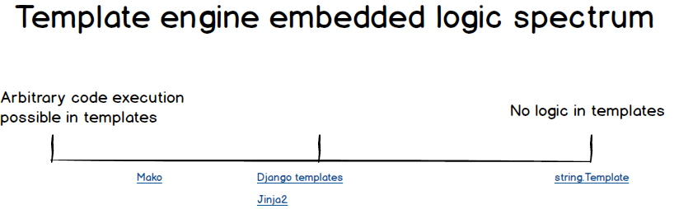
Template Engines - Alternativas
Mako (Ex. de framework: Pyramid / Ex. de website: Reddit)
Genshi (Ex. de framework: TurboGears v.2+ / Ex. de website: SourceForge)
DTL (Ex. de framework: Django / Ex. de website: Instagram)
Web2py Template Language (Ex. de framework: Web2py / Ex. Website: Tag Inspector)
SimpleTemplate (STPL) (Ex. de framework: Bottle)
Cheetah
Etc.

Slide 5
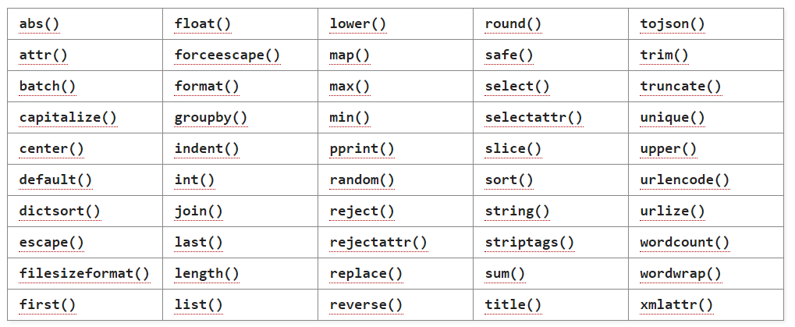
Builtin Filters
«Variables can be modified by filters. Filters are separated from the variable by a pipe symbol (|) and may have optional arguments in parentheses. Multiple filters can be chained. The output of one filter is applied to the next. For example, {{ name|striptags|title }} will remove all HTML Tags from variable name and title-case the output (title(striptags(name))). Filters that accept arguments have parentheses around the arguments, just like a function call. For example: {{ listx|join(', ') }} will join a list with commas (str.join(', ', listx)).»

